Slide 1
London | Matchmaking Meetups
XYZ Event Agency
Introduction & Partnership Presentation

Slide 2
About Us
XYZ is a Marketing & Tech Event Agency based in London that delivers and implements event, marketing & PR services exclusively to the IT industry.
XYZ is a Marketing & Tech Event Agency based in London that delivers and implements event, marketing & PR services exclusively to the IT industry.
XYZ is a Marketing & Tech Event Agency based in London that delivers and implements event, marketing & PR services exclusively to the IT industry.

Slide 3
Our Tech Shows
REFERENCE LOGOS
REFERENCE LOGOS
OUR REFERENCE EVENT1 brings together cloud innovators, technologists, and business leaders, to help them shape their future and deliver successful digital transformation.
OUR REFERENCE EVENT2 brings together hosting /domain providers, web pros, e-commerce leaders, and WordPress enthusiasts to talk about the future of web technologies.

Slide 4
Stats of Our Global Events
3
5+
10.000+
300+
Countries
Years
Participants
Speakers

Slide 5
Watch Our Last Meetup Recap
REFERENCE EVENT VIDEO(S)

Slide 6
Former Event Partners
LOGO
LOGO
LOGO
LOGO
LOGO
LOGO
LOGO
LOGO
LOGO
LOGO

Slide 7
XYZ Event Agency
London | MatchMaking Meetups
Unlock the right opportunities and connections that will set your business apart

Slide 8
The UK is the largest cloud market in Europe.
Second largest ICT market in the ranking of ICT spending per head (U.S. #1)
London second most connected place for tech, right after Silicon Valley
No. 1 top scaling tech nation in Europe
No. 1 destination for U.S. ICT businesses in Europe (often serving as EMEA HQ)
15.6B $
26.9B $
100.000+
5.27B $
Public Cloud Revenue
Expected by
2026
Software Companies
IaaS & PaaS
Revenue
Resource : https://www.trade.gov/

Slide 9
About CloudTalk London Meetups
London | MatchMaking Meetups is a community-led events platform, where senior technology leaders from the UK can share innovative ideas, challenge conventional thinking and build strategic relationships.
1ꓽ1 meetings and collective networking areas and private workshops, drink ups, and many more exciting additions based on experience and innovation. A perfect chance for networking and making new business contacts

Slide 10
IT’s a MatchMaking Meetup
Live Presentations and Panels
Live Technical Workshops
Q&A Round Tables
Discussion and Meeting Opportunity with Speakers
1-to-1 B2B Meetings
Instant 1-to-1 Text Chat
Networking & Meeting Areas
Viewing All Participants
Calendar Management

Slide 11
Unique networking experience with Deal Room event technology

Slide 12
Key Topics
Cloud Adoption
Digital Transformation
Cloud Security
Multi-Cloud
Hybrid Cloud
Cloud Native
Microservices
IaaS-PaaS
DevOps
Transition of Datacenters to Cloud
DX Optimization
Hyper-converged Infrastructures

Slide 13
Next Meetup Event
Event Theme
Date
Time
Venue
Participants
Autonomous Digital Infrastructure with Cloud
September 15, 2022 - Thursday
18:00 - 22:00
Huckletree Shoreditch
100 - 200
:
:
:
:
:

Slide 14
What to Expect
1
100+
4
8
1
Day
Participants
Sessions
Speakers
MatchMaking Drink Up

Slide 15
Program
Time | Program
18:00 - 18:30 | Speed Networking
18:30 - 19:15 | Panel : Enterprise Cloud Transformation and Supporting Autonomous Digital Infrastructure
19:15 - 19:35 | Sponsored Presentation
19:45 - 20:45 | Networking & B2B Table Meetings

Slide 16
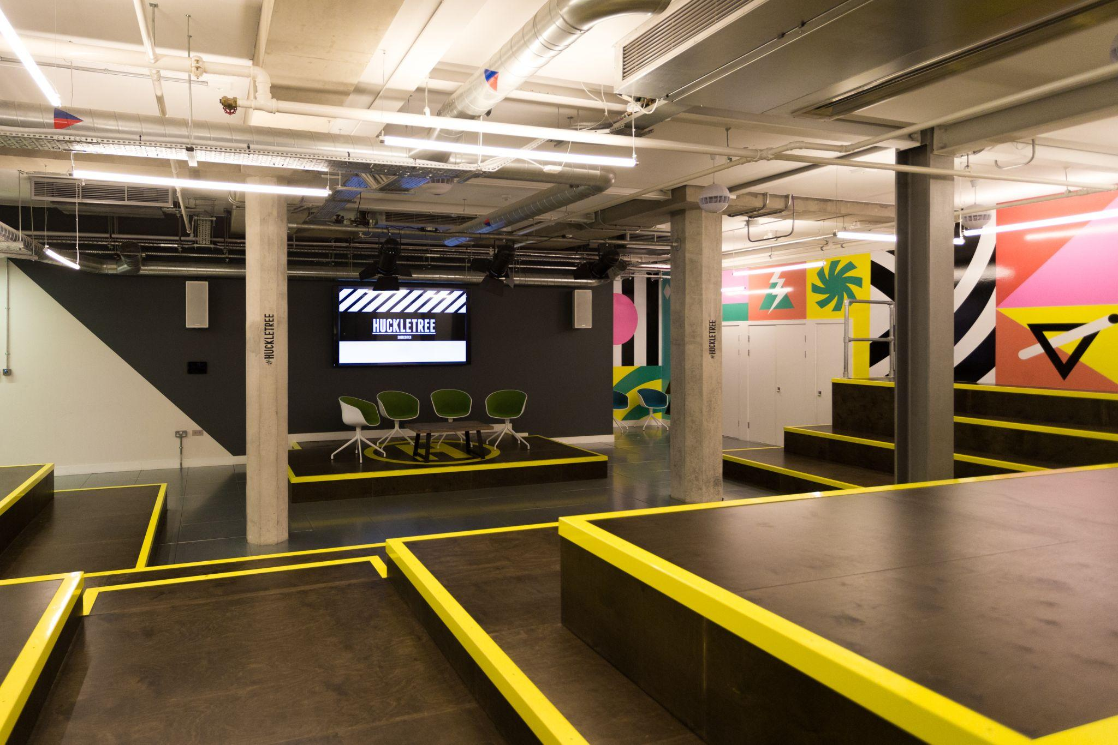
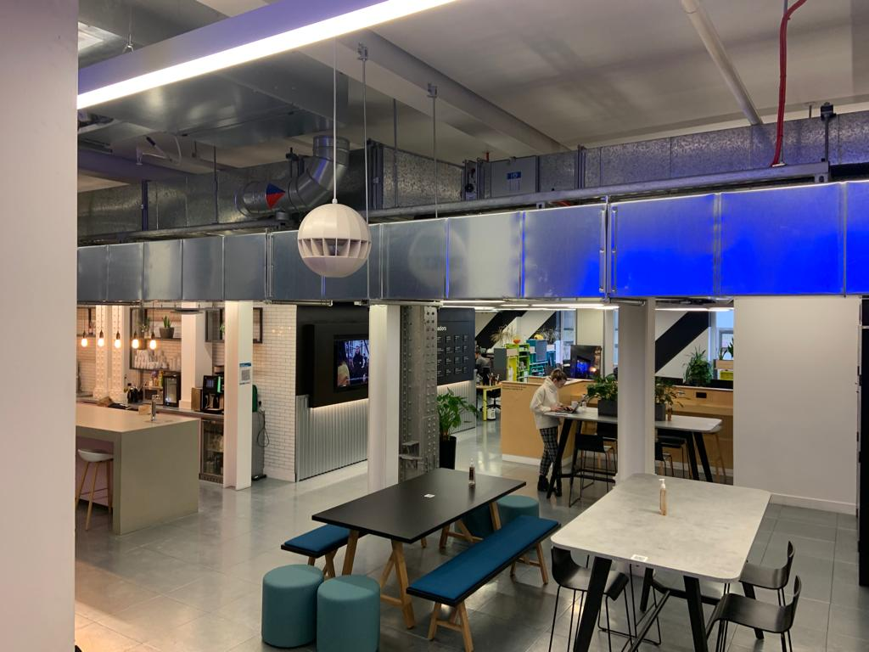
Event Venue
Huckletree is the perfect venue for events in the heart of the London
East Central London center is based in the Iconic Alphabeta building on Finsbury Square. In this ambitious community, you’ll find brands that are disrupting their verticals.

Slide 17
Marketing Opportunities

Slide 18
Sponsorship Items | Gold | Platinum | Diamond
Speaking slot
All solicited data
Post-event introductions |  | 5 | 10
Material distribution(leaflet, brochure, etc.)
Rollup at stage
Mailing solicited participant data
Rollup at event platform
Logo display on digital platforms
Video display at breaks
Price | PRICE INFO | PRICE INFO | PRICE INFO

Slide 19
Other Branding Opportunities

Slide 20
Price info
Price info
Price info
Badge Partnership
Drink Up Partnership
Notebook/Pen
Your logo appears on the name badge which will be carried out by participants during the event
Your logo is placed on the drinks served to the participants at networking party, at the end of the event
The notebooks with your logo are distributed to the participants who come to the event during registration.

Slide 21
Price info
Price info
Price info
Other Partnership
other Partnership
Other Partnership
Details
Details
Details

Slide 22
Thank you
For Partnership Queries
CONTACT INFO

